Slide 1
Manufacturing of Salicylic acid & Steady State Analysis of Absorption Column
Guide: Dr. T.K. Radhakrishnan
By-
Divya Jagannathan (102110017)
Sivaranjini .S (102110057)
Nandhini.V (102110038)

Slide 2
ABSTRACT
Manufacturing of Salicylic acid is studied using Kolbe-Schmitt process. Unit processes and operations are identified, and utility requirements are obtained by Material and Energy Balance.
Steady-state analysis of an Absorption column has been studied in MATLAB using Murphree’s tray efficiency as a parameter.

Slide 3
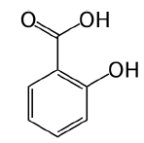
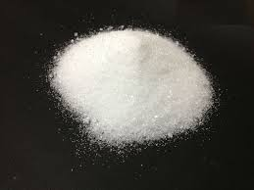
SALICYLIC ACID: A GENERAL INTRODUCTION
It is a monohydroxybenzoic acid with a chemical formula of C₆H₄(OH)COOH
Appearance: Colourless to White crystals
Names and Identifiers:
IUPAC Name: 2-hydroxybenzoic acid
Other names: o-hydroxybenzoic acid,
2 carboxyphenol

Slide 4
USES
Pharmaceutical Uses: It is a precursor to preparation of Aspirin. It is used as antiseptic and antifungal in veterinary medicine. It is also used to treat dermatological conditions as Comedolytic agent
Cosmetic Uses: Salicylic acid is used as preservative in cosmetic products and as Keratolytic agent.
It is used as preservative in Food and chemical raw material for preparation of synthetic dyes.

Slide 5
SAFETY ASPECTS
Effects on Humans-
Eye - On prolonged exposure, it causes corneal injury
Skin - Skin burns and irritation are observed for wet or
moist skin
Ingestion - Causes gastrointestinal irritation with nausea. It may cause Salicylism
Inhalation - Causes irritation of mucous membrane and upper respiratory tract
Due to the above effects, workers handling Salicylic acid on regular basis in factory must wear Eye protection gears, appropriate gloves and nasal mask to prevent contact or ingestion.

Slide 6
INDUSTRIAL SYNTHESIS: KOLBE-SCHMITT PROCESS
Kolbe-Schmitt process is the most extensively used
method for industrial manufacturing of Salicylic acid
It involves three major chemical reactions-
C₆H₅OH + NaOH → C₆H₅ONa + H₂O
2C₆H₅ONa + CO₂ → (ONa)C₆H₄COONa + C₆H₅OH
ONaC₆H₄COONa + H₂SO₄ → OH-C₆H₄COOH + Na₂SO₄
Raw materials are introduced at 312K and 1 atm
Yield of the Reaction: 40-59% at low pressures
80-90% at high-pressures

Slide 7
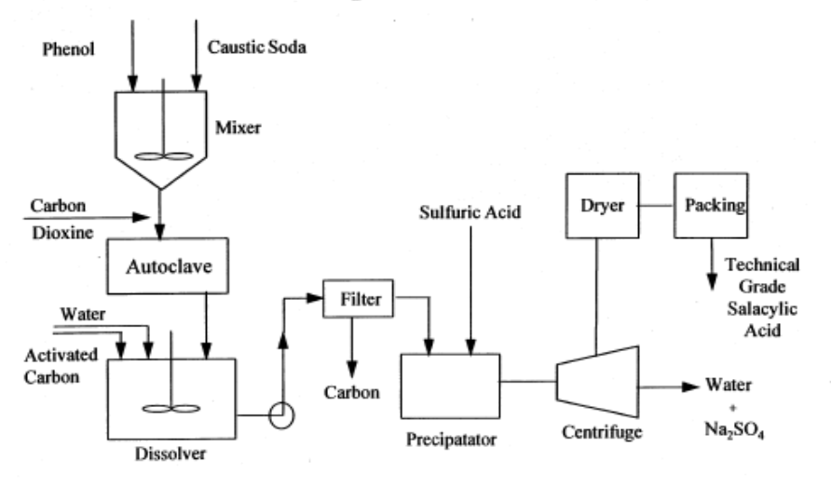
FLOW SHEET FOR SALICYLIC ACID PRODUCTION

Slide 8
UNIT PROCESSES AND OPERATIONS
MIXING:
It is a mechanical operation used to mix Phenol and Caustic soda at 39ºC.
AUTOCLAVE HEATING:
Carboxylation reaction takes place in autoclave at 130ºC to form Sodium salicylate.
FILTRATION AND DISSOLUTION:
Sodium salicylate is purified by adding water (dissolution) and adding activated carbon to remove any colouration.
PRECIPITATION:
Sodium salicylate solution is acidified using Sulphuric acid to
form Salicylic acid

Slide 9
CENTRIFUGATION:
Salicylic acid crystals and the solution are separated in the
Centrifuge
DRIER:
The separated Salicylic acid crystals are dried in a rotary-type
drier in counter-current mode of operation through heat
exchange between hot air and the moist crystals. The
salicylic acid crystals loose moisture from 35% to 15%.

Slide 10
SELECTION OF EQUIPMENTS
i. Mixer: Static Mixer
Feed streams to the Mixer in the case of Salicylic acid manufacturing are liquids. Also, they are less viscous fluids. Thus, a static mixer is suitable for such operation
ii. Filter: Cartridge Type
In filter, the Sodium phenolate solution is decolorized using activated Carbon. Cartridge filter can be used as it can house the decolorizing agent effectively.
iii. Centrifuge: Tubular bowl Centrifuge
Since the streams to be separated are both in liquid phases, this centrifuge is appropriate for operation.
iv. Drier: Rotary-type Drier
Due to the requirement of Sterile environment for processing of Salicylic acid as a pharmaceutical precursor, Rotary-type Drier is preferred.

Slide 11
MATERIAL BALANCE
Basis- 0.5 ton/day of Salicylic Acid
Raw Materials Required-
Phenol - 800 kg = 8.51 Kmol (Limiting Reagent)
Caustic Soda - 350 kg = 8.75 Kmol
Material Balance based on Mole-balance in Chemical Reactions:-
Reaction in Mixer: C₆H₅OH + NaOH C₆H₅ONa + H₂O
8.51 Kmol 8.51 Kmol 8.51 Kmol 8.51 Kmol
Reaction in autoclave :
2C₆H₅ONa + CO₂ (ONa)C₆H₄COONa + C₆H₅OH
Reaction in Precipitator:
ONaC₆H₄COONa + H₂SO₄ OH-C₆H₄COOH + Na₂SO₄

Slide 12
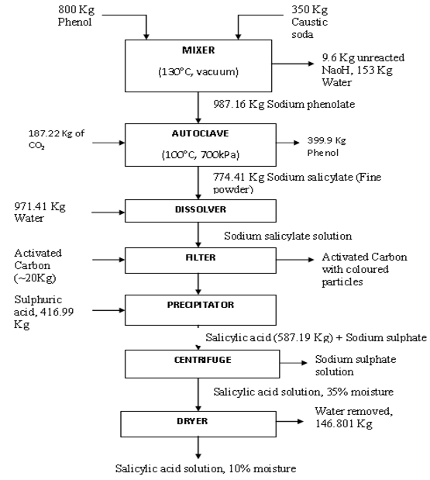
15% moisture
Notes:
Water as utility per 0.5 ton production = 971 kg, recycle = 153 kg

Slide 13
ENERGY BALANCE
Energy balance is critical in determining the quantity of utilities to be used. In this case, cooling water and steam have been used as heat source and supply respectively.
Governing equation for Reaction:
Heat Input + Heat Supply = Heat Output + Heat Generated
Heat Input = Internal energy carried by reactants
Heat Output = Internal energy carried by products
Heat Supply/Generated = Heat consumed/liberated based on whether the reactions are endothermic or exothermic

Slide 14
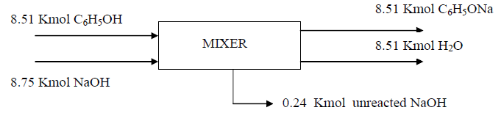
Illustration: Mixer
Reference Temperature = 25ºC
ΔT = T_{feed} – T_{ref} = 39 – 25 = 14ºC
Heat Input :(mC_{P} ΔT)_{Phenol} + (mC_{P} ΔT)_{Caustic Soda} = 2.34*10⁷ J/day
Heat Output :(mC_{P} ΔT)_{Sodium phenolate} + (mC_{P} ΔT) _{Water} +
(mC_{P}ΔT)_{Unreacted} _{Caustic} _{Soda}
= 1.47*10⁸ J/day
Heat Supplied = Heat Output – Heat Input = 1.23 * 10⁸ J/day
Heat is to be supplied using Steam:
(Mλ)_{Steam} = 1.23 * 10⁸
=> M_{steam} = 46.1 Kg/day

Slide 15
UTILITY & DESIGN REQUIREMENTS
Water required for dissolution = 971 Kg/day
Water produced in the process = 153 Kg/day
Steam required for heating = 46.1 Kg/day
Cooling water required = 460 Kg/day
Drier dimensions-
Length = 2.13 m
Shell diameter = 0.304 m

Slide 16
COST ESTIMATION
Fixed Investment Cost is obtained using the Cost Index
The following Costs are estimated as a fraction of Fixed Investment Cost:
Direct Cost
Indirect Cost
Total Production Cost
Gross Earnings are calculated assuming that the plant works
for 300 days per year and the selling price of a kilo bag of Salicylic acid is Rs. 900.
After tax deduction, a net Profit of Rs. 3.02 Crore is obtained in operating a plant of 182.5 Tonnes per year capacity.

Slide 17
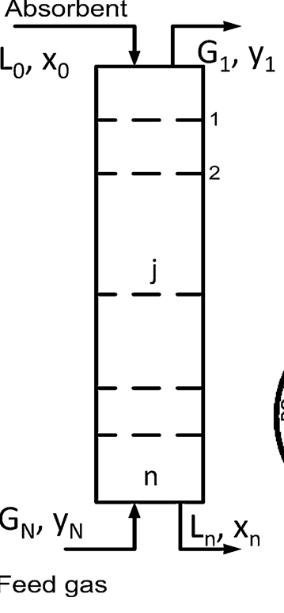
STEADY STATE ANALYSIS OF ABSORPTION COLUMN USING MATLAB
A steady state model is obtained for the coupled hydrodynamics and mass transfer of the absorption column
The gas phase and liquid phase compositions along the trays of the absorption column are obtained with Murphree’s tray efficiency as the parameter
Murphree’s tray efficiency is given by-
η = (y_{j} - y_{j+1})/(y_{j}* - y_{j+1})

Slide 18
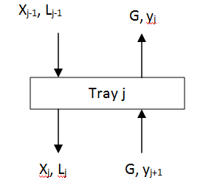
Material and Component Balance across the tray:
(dMj / dt) = L_{j-1} + G – L_{j} –G
d (M_{j}x_{j})/dt= x_{j-1} L_{j-1} – x_{j} L_{j} + G(y_{j+1} – y_{j})
Equating these equations to zero for steady-state condition, a generalised matrix set of equations are obtained:
A_{x}x = -Δy + Bu (8.6)
A_{y} y = - k η x – (1- η) y_{in} ν (8.11)
On solving 8.6 and 8.11, steady state solution is obtained.

Slide 19
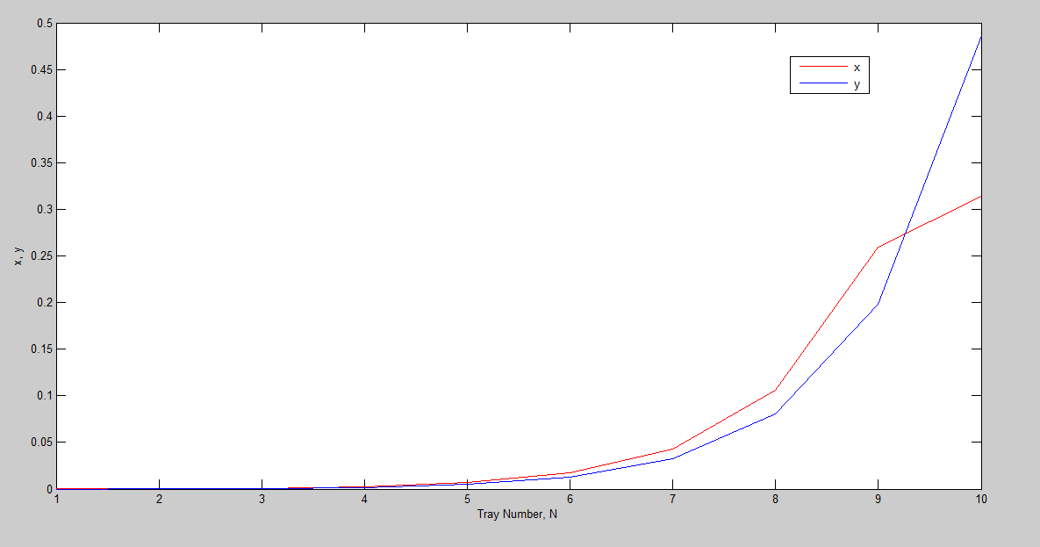
GRAPHICAL RESULT
A plot between the x,y and the tray number is obtained at the steady state conditions. The plot is found to be non-linear with respect to the tray number.

Slide 20
FUTURE SCOPE OF THE PROJECT
In the Kolbe-Schmitt Process, Crystallisation Unit can be included for obtaining higher purity grade of Salicylic acid. Crystallisation will also allow the production of needle-like crystals which eases the processing of Salicylic acid in tablet forms.
The stead-state model obtained for Absorption column can be used for the study of dynamic performance of the absorption column with Murphree’s tray efficiency as the parameter .

Slide 21
Thank You

